Slide 1
Traveller Online

Slide 2
Who are we?

Slide 3
What did we do?

Slide 4
What did we use?
Java
Hibernate API
Spring framework and Lombok
MySQL
Argon framework
Postman

Slide 5
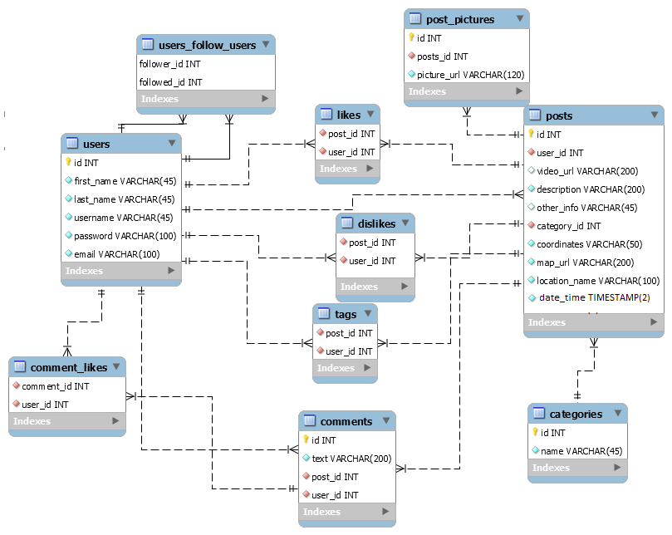
ER DIAGRAM

Slide 6
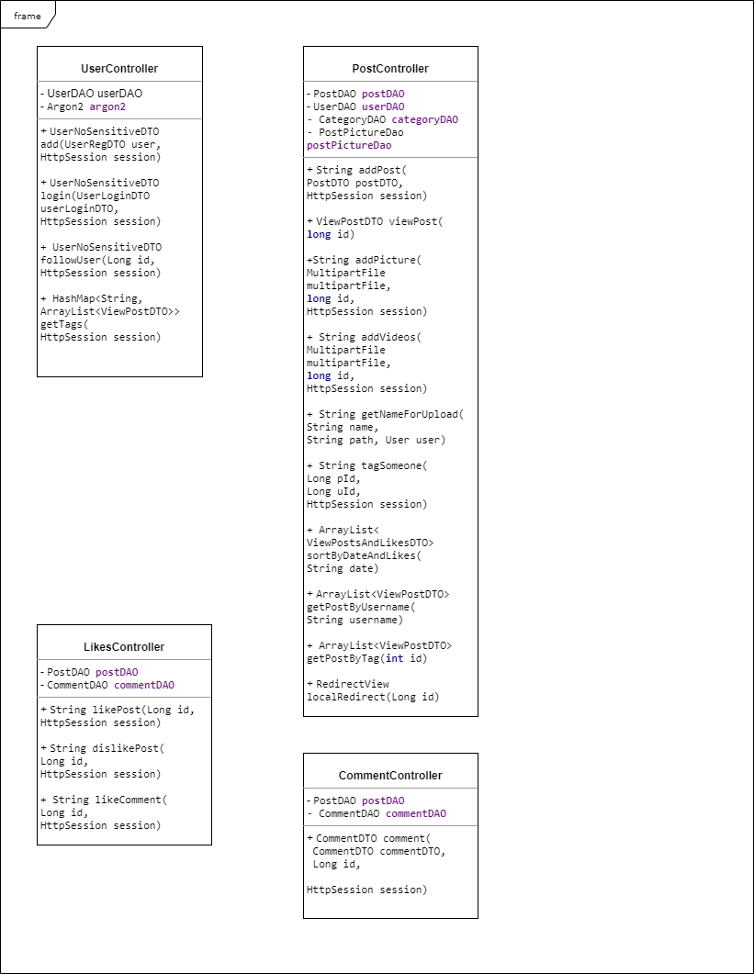
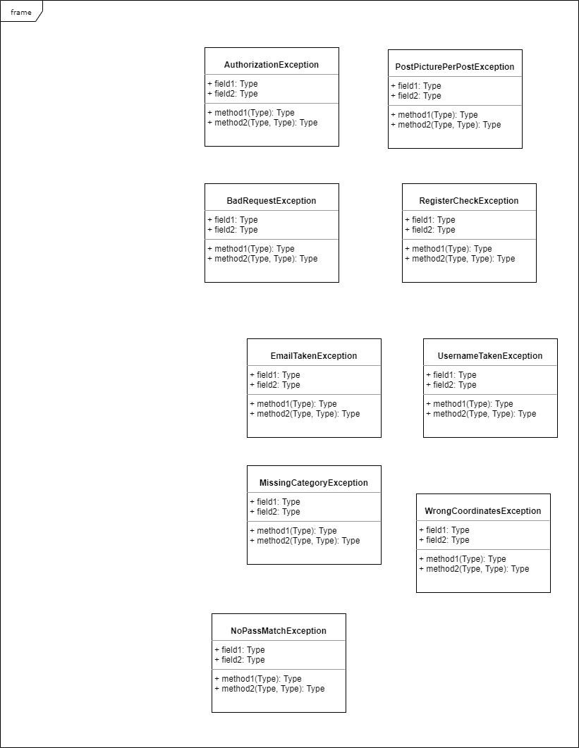
Class Diagrams

Slide 7
Let’s get started!

Slide 8
Any questions?

